Slide 1

FINAL PROJECT REPORT
Module CDM
Concepts of
Data Mining
Automated Data Mining and Pattern Discovery System
A secondary internal analysis lab operating over a frozen news corpus to auto-categorize, cluster, and discover underlying event correlations analytically
2026
120,000+ Articles
Pattern Discovery

Slide 2
AGENDA
Table of Contents
01
Project Overview & Objectives
02
System Architecture
Core goal, 9-week development timeline, and key milestones from preprocessing to empirical testing
Unsupervised and supervised data mining pipelines, interactive visual discovery lab
03
Challenges & Resolutions
04
Evaluation & Results
Three critical technical obstacles and engineering solutions implemented
Empirical metrics, SVM vs Naive Bayes benchmarks, and FP-Growth findings
05
Conclusion & Future Scope
Summary of achievements and roadmap for time-series anomaly forecasting and live backend integration

Slide 3

CHAPTER 01
Project Overview
& Objectives
Goal, timeline, and key objectives of the CDM module

Slide 4
PROJECT OVERVIEW
Objectives & Timeline
Core Objective
Engineer a secondary internal analysis lab operating over a frozen news corpus to auto-categorize, cluster, and discover underlying event correlations analytically. While the IR system fulfills user queries, the CDM engine uncovers mathematically correlated subtext without external prompting.
9-Week Development Timeline
1-2
Data Preprocessing
3
Text Normalization
4
Association Mining
Cleaned 120k row frozen_corpus.csv, generated unified Pandas structures
Vectorized content using 5,000-feature TF-IDF maps, tested memory safety
Implemented Apriori rules, experienced memory crashing, bounded parameters
5
Classification Models
6
Clustering & Outliers
7
Refactoring Apriori
Developed multi-category pipeline comparing Multinomial NB vs Linear SVM
Built Bisecting K-Means on LSA matrices to isolate topic themes and outliers
Replaced Apriori with FP-Growth FP-trees logic (mlxtend) for efficiency
8
Interactive Visual UX
9
Empirical Testing
System Complete
Developed Python-to-JSON bridges for Chart.js 2D PCA Scatter interfaces
Fixed HTTP 500 edge cases, ran silhouette score validations, benchmarks
Fully integrated data mining lab with visual discovery

Slide 5
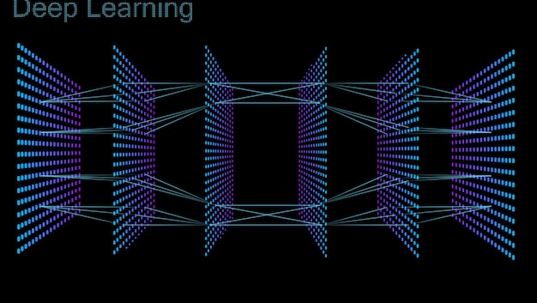
CHAPTER 02
System
Architecture
Unsupervised and supervised data mining pipelines

Slide 6
SYSTEM ARCHITECTURE
Unsupervised Pipeline: Clustering & Association
01
Dimensionality Reduction
02
Bisecting K-Means
03
FP-Growth Association
The Challenge
Why Bisecting?
The Upgrade
Operating K-Means on 10,000-column TF-IDF matrix is fundamentally flawed (Curse of Dimensionality)
Standard K-Means struggled with high-variance corpus; strict binary division is superior
Replaced legacy Apriori entirely with FP-Growth via mlxtend
Implementation
Memory Efficiency
The Solution
Groups events together natively via strict binary division
Constructs conditional pattern trees — no astronomical permutation tracking
Utilized TruncatedSVD (LSA) to reduce to exactly 100 mathematical vectors
Outlier Detection
Lift Correlation
Impact
Collections smaller than mean norm flagged as potential reporting "outliers"
Calculates raw keyword correlations with algorithmic Lift > 1.25
Eliminates low-value vocabulary noise, drastically improves clustering speeds
10,000 → 100 dimensions
Distinct topic isolation
Latent patterns discovered
Key Innovation: The unsupervised pipeline converts 10,000-dimensional TF-IDF vectors into 100 LSA components, applies strict binary division for topic isolation, and discovers latent keyword correlations via memory-efficient FP-Growth — all without human supervision.

Slide 7
SYSTEM ARCHITECTURE
Supervised Pipeline: Classification Benchmark
Dual-Model Competition
Linear SVM (Winner)
Instead of forcing a single classification paradigm, the architecture automatically splits testing sets identically and forces both models to race, actively showcasing which parses journalism context better in real-time.
Type
Dimensional hyperplane model (Linear SVC)
Strengths
Multinomial Naive Bayes
Finds optimal separating hyperplane in high-dimensional TF-IDF space
Type: Probabilistic model based on Bayes' theorem
Performance
Strengths: Fast training, works well with high-dimensional data
Universally outperformed Naive Bayes across all accuracy metrics on journalistic texts
Limitation: Assumes feature independence — struggles with text correlations
Baseline model for comparison
Live Benchmarking UI
Dual-training visualization showing real-time accuracy comparison
Live Inference box with confidence interval progress bars
Categories: Sports, Business, Tech classification testing

Slide 8
SYSTEM ARCHITECTURE
Interactive Visual Discovery Lab
5-Panel Mining Sub-Navigation
Live Operations
Frozen Corpus
Warehouse
Preprocessing
Association
Classification
Clustering
Algorithms run on verified "Frozen" internal corpus for mathematical repeatability
Ingestion
TF-IDF
FP-Growth
SVM vs NB
K-Means
PCA Visualization Pipeline
API Response Speed
Guaranteed fast response times via static dataset optimization
1
100D K-Means Spaces
Bisecting K-Means operates on 100 LSA components
2
PCA Projection
Unified Pipeline
Principal Component Analysis projects to 2D X-Y mappings
Users step through all 5 stages directly from UI without touching code
3
Interactive Chart.js
2D scatter plots with JSON payload to custom Javascript layout
Visual Validation
Silhouette scores and weighted purity measure mathematical isolation quality

Slide 9
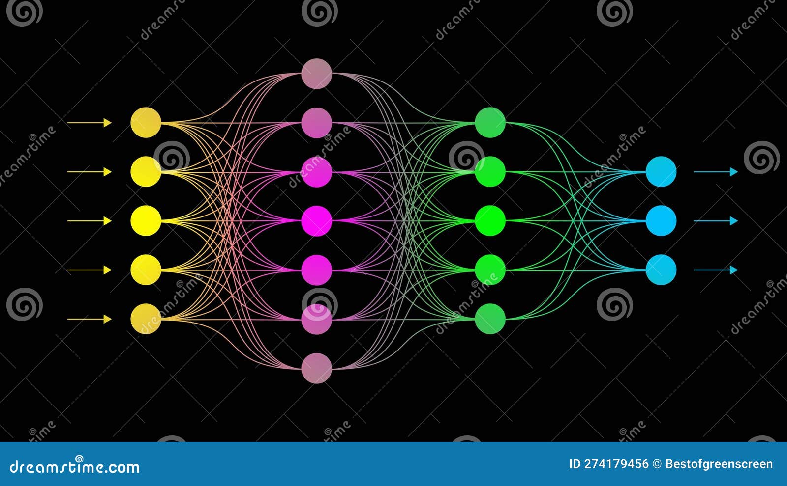
CHAPTER 03
Challenges &
Resolutions
Key technical obstacles and engineering solutions

Slide 10
CHALLENGES & RESOLUTIONS
Three Critical Challenges
01
Apriori Memory Overruns & "No Rules Found"
The Problem
The Resolution
Passing 120,000 articles with 10,000 variables into Apriori crashed due to astronomical permutation overhead. High bounds caused HTTP 500 exceptions when zero results found.
Switched to FP-Growth via mlxtend — significantly reduced processing overhead. Modified codebase to interpret "zero" conditions gracefully, returning clear visualization arrays.
02
Scipy CSR Matrix Incompatibility
The Problem
The Resolution
Pandas boolean string arrays caused .nonzero() index fault crashes against Python sparse arrays in scikit-learn during advanced keyword parsing
Diagnosed memory-space bounds and resolved by appending numpy .values extraction to feed primitive formats back into the vector engine
03
Inability to Visualize High-Dimensionality
The Problem
The Resolution
Users cannot see 10,000 dimensions of TF-IDF vectors representing K-Means clusters — impossible to interpret or validate visually
Utilized PCA in mining_engine.py to project complex 100D spaces to X-Y mappings interfacing via JSON payload to Chart.js visual layout

Slide 11

CHAPTER 04
Evaluation
& Results
Empirical metrics and performance validation

Slide 12
EVALUATION & RESULTS
Evaluation Metrics & Findings
SVM Dominance
FP-Growth Lift Identification
Classification Benchmark Results
Lift Threshold Optimization
The Live Linear SVM universally outperformed Multinomial Naive Bayes across raw accuracy metrics on journalistic texts
Standard support metric thresholding completely skewed relevant rules; incorporated Lift > 1.25 for meaningful correlations
Validation
Autonomous Discovery
Confirmed as the offline category predictor of choice for Sports, Business, Tech classification
Module mathematically draws connections autonomously — e.g., World Events → Technical Market adjustments
Live Confidence
Pattern Examples
UI displays real-time confidence interval progress bars for unknown string classifications
Successfully extracts latent pattern connections with measured Lift correlations (e.g., "Inflation" → "Global Oil Prices")
System Validation Summary
SVM outperforms Naive Bayes across all text categories
Silhouette Score Validation
FP-Growth discovers meaningful associations without crashing
Rigorous silhouette score validations performed on clustering boundaries to measure mathematical isolation quality and confirm optimal cluster count.
Bisecting K-Means achieves validated cluster isolation
PCA visualization enables intuitive cluster exploration

Slide 13
CONCLUSION & FUTURE SCOPE
Conclusion & Future Scope
Project Conclusion
Future Scope
Successfully implemented both supervised benchmarking algorithms (SVM vs Naive Bayes) and unsupervised clustering isolation methods (Bisecting K-Means)
Time-Series Anomaly Forecasting
Add deeper time-series anomaly detection routines to identify trending patterns and forecast emerging topics
Data Mining module effortlessly converts previously unused data troves into mathematically verifiable business-intelligence visual graphs
FP-Growth association rules autonomously discover latent patterns (e.g., Inflation → Global Oil Prices) with Lift > 1.25
Live Backend Integration
Transition from static frozen_corpus to live updating backend warehouse with dynamic daily chart rebuilding
Interactive 5-panel visual lab enables zero-code exploration of warehouse, preprocessing, association, classification, and clustering
Real-Time Event Cascade
Key Achievements
Dynamically rebuild charts daily as news events cascade, providing always-current business intelligence
Supervised
Unsupervised
SVM vs NB racing
K-Means + FP-Growth
Vision: An autonomous data mining engine that continuously discovers, categorizes, and visualizes patterns from live news streams without human intervention.
PCA Visualization
Pattern Discovery
2D cluster exploration
Lift correlations

Slide 14
Thank You
Concepts of Data Mining
Final Project Presentation
Clustering
Pattern Discovery
Classification
Bisecting K-Means
FP-Growth
SVM vs Naive Bayes

